Slide 1
PAWN GOATS
The Blockchain Pawn Shop
Nick Geigel
Trevor Radomski
Alex Nasca

Slide 2
Problem Statement
How can a person pawn an item securely and remain anonymous?
How can the pawnshop execute this whole pawning processes with zero trust in the pawner?

Slide 3
Step 1: Deploy the Contract and Fund With Ethereum
Send 10 Eth to Business Contract
Deploy Contract on Ganache using Ethers
Business Contract
Balance: 10 Eth
Notes:
trev

Slide 4
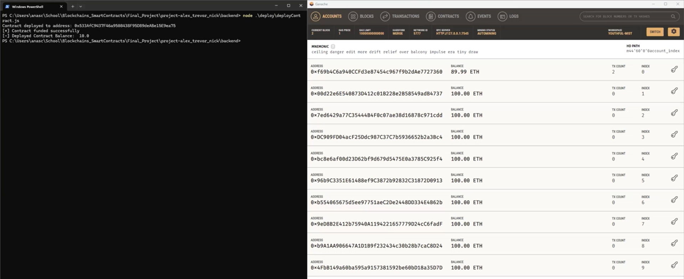

Slide 5
Step 2: Pawner Requests A Pawn Deal & Pawn Shop Accepts
Pawner Goes to website and requests a transaction:
Item
Loan Amount
Length of loan and interest rate
API Call to create order
1
Business Contract
Balance: 10 ETH
Stores: Offer
2
Contract sends back order ID to check status, updates order in Admin page
4
subcontract representing this deal is generated
3
Pawn Shop Admin Accepts Offer
API Call to Accept Order
Transaction Contract
Balance: 0 ETH
Stores: Order info
Pawner can now see the address they must pay to start the process
5
The Business contract sends back the address of the newly created transaction contract
Frontend
Backend
Blockchain
Notes:
trev

Slide 6
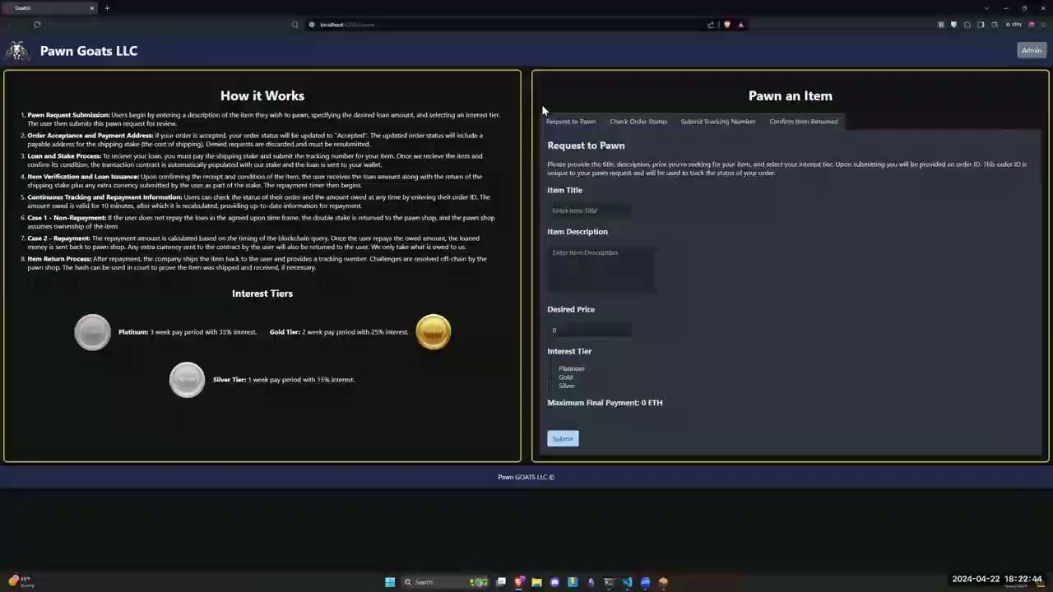

Slide 7
Step 3: Pawner Stakes for Shipping
Pawner Wallet
Balance 99 ETH
Business Contract
Balance: 8 ETH
2
Business Contract auto-stakes double the loan amount
Transaction Contract
Balance: 3 ETH
Loan Amount: 1 ETH (not in contract yet)
1
Pawner stakes 1ETH for shipping
Blockchain
Notes:
nick

Slide 8
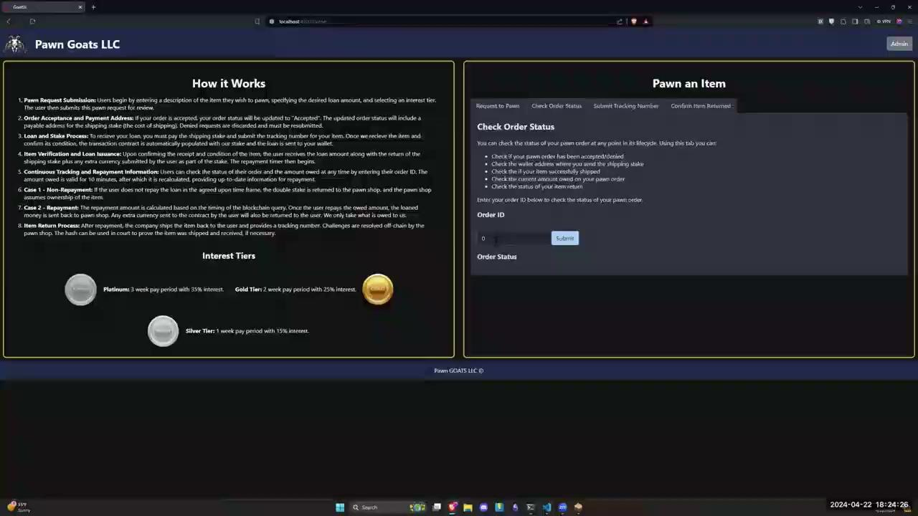

Slide 9
Step 4: Pawner Ships Item, Shop Confirms Shipping
API Call to hash and store tracking number
Pawner submits shipping tracking number
Business Contract
Balance: 7 ETH
Stores: Offer
1
API Call to confirm item received
3
Send the Loan Amount to the contract
Pawn Shop Admin confirms item has arrived and meets description
2
Transaction Contract
Balance: 4 ETH
Loan Amount: 1 ETH
Frontend
The subcontract directly pays the shipping stake + loan to the pawner
Pawner Wallet
Balance: ~101 ETH
Transaction Contract
Balance: 2 ETH
Loan Amount: 1 ETH
4
Outside
Backend
Blockchain
Notes:
nick

Slide 10
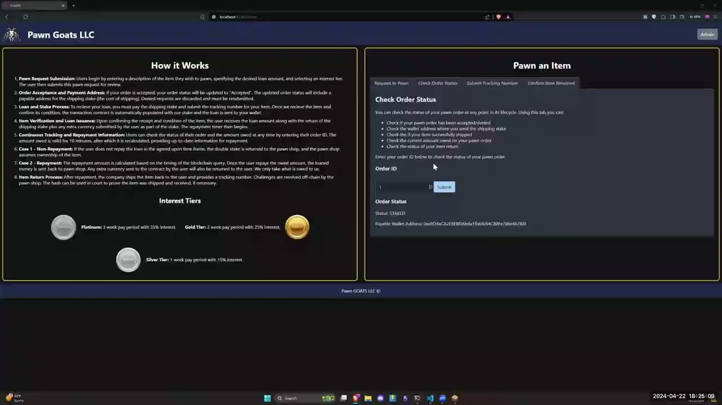

Slide 11
Step 5: Pawner Requests Loan Balance and Pays Back
API Call to Get Loan Amount
Business Contract
Balance: 8 ETH
Stores: Offer
Pawner requests loan balance on website
1
4
Business contract calls function in Transaction Contract.
Transaction Contract returns interest amount
3
2
API returns loan amount plus interest to pawner.
Transaction Contract
Balance: 2 ETH
Subcontract calculates interest amount at that time
Frontend
Pawner Wallet
Balance:
100 ETH - interest
Pawner has 10 minutes to pay the loan + interest calculated in step 2
Transaction Contract
Balance: 3 ETH + interest
Outside
5
Backend
Blockchain
Notes:
Alex

Slide 12
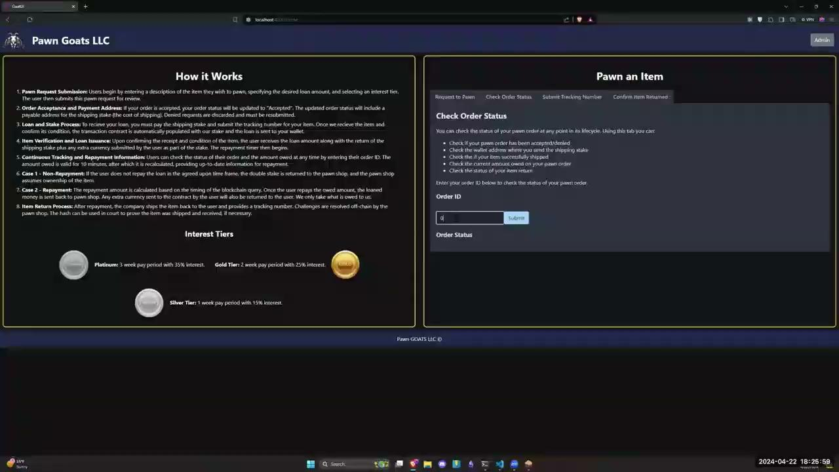

Slide 13
Step 6: Shop Ships Back Item and Pawner Confirms Shipping
Pawn shop admin submits shipping tracking number
API call to contract to create hash of shipping ID and store it
1
Business Contract
Balance: 10 ETH + interest
Hash created and stored in Transaction Contract
2
Transaction Contract sends back stake and loan + interest made
API Call to confirm shipping
3
Pawner confirms shipping received on website
Transaction Contract
Balance: 0
Stores: tracking hash in order
Frontend
Backend
Blockchain
Notes:
alex

Slide 14
